Slide 1
Tree Data structure
Presenter: Trinh Cao Cuong
4/2024

Slide 2
Table of contents
1. Definition
2. Binary search tree
3. Routing Table
4. Avl tree
5. red-black tree

Slide 3
1.
definition

Slide 4
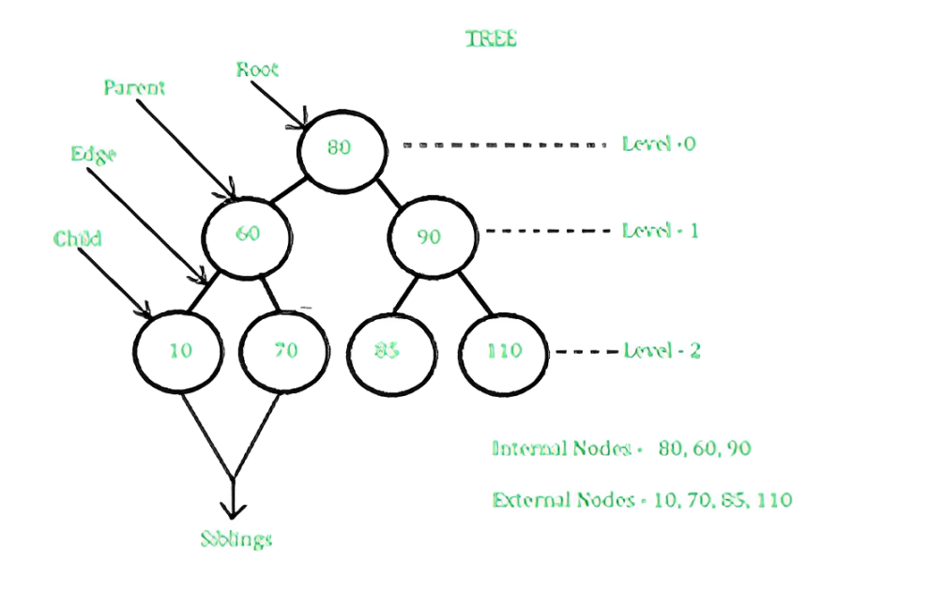
definitions : What is tree data structure ?
Tree is a non-linear data structure. It consists of nodes and edges. A tree represents data in a hierarchical organization. It is a special type of connected graph without any cycle or circuit.

Slide 5
definitions : Advantages
Efficient searching: efficient for searching and retrieving data. The time complexity of searching in a tree is typically O(log n)
Flexible size: can grow or shrink dynamically depending on the number of nodes that are added or removed.
Easy to traverse: Traversing a tree is a simple operation, easy to retrieve and process data from a tree structure.
Easy to maintain: Trees are easy to maintain because they enforce a strict hierarchy and relationship between nodes. This makes it easy to add, remove, or modify nodes without affecting the rest of the tree structure.
Natural organization: natural hierarchical organization useful for representing things like file systems, organizational structures, and taxonomies.
Fast insertion and deletion: Inserting and deleting nodes in a tree can be done in O(log n) time

Slide 6
definitions : Disadvantages
Memory overhead: require a significant amount of memory to store, especially if they are very large.
Imbalanced trees: non balanced tree can result in uneven search times
Complexity: can be difficult to understand and implement correctly.
Limited flexibility: While trees are flexible in terms of size and structure, they are not as flexible as other data structures like hash tables.
Inefficient for certain operations: inefficient for other operations like sorting or grouping.

Slide 7
definitions : Disadvantages
Memory overhead: require a significant amount of memory to store, especially if they are very large.
Imbalanced trees: non balanced tree can result in uneven search times
Complexity: can be difficult to understand and implement correctly.
Limited flexibility: While trees are flexible in terms of size and structure, they are not as flexible as other data structures like hash tables.
Inefficient for certain operations: inefficient for other operations like sorting or grouping.

Slide 8
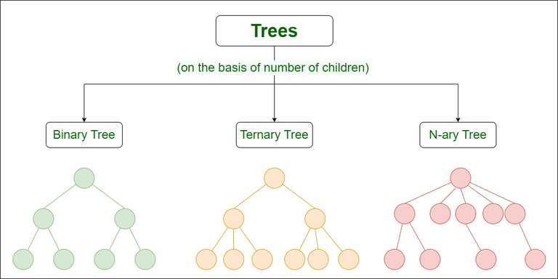
definitions : types of tree
Types of Trees based on the number of children:
Binary tree: each node of this tree has only 2 children
Ternary tree: each node has at most three child nodes, usually distinguished as “left”, “mid” and “right”.
N-Array tree (Generic tree): a collection of nodes where each node is a data structure that consists of records and a list of references to its children (not duplicate references).

Slide 9
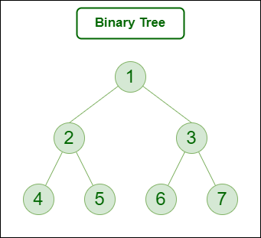
definitions : types of tree
Types of Trees based on the node’s values:
Binary search tree: a node-based binary tree data structure that:
+ The left subtree of a node contains only nodes with keys lesser than the node’s key.
+ The right subtree of a node contains only nodes with keys greater than the node’s key.
+ The left and right subtree each must also be a binary search tree.
AVL tree
Red-Black tree
B and B+ tree
Segment tree

Slide 10
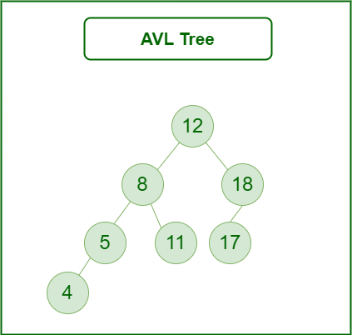
definitions : types of tree
Types of Trees based on the node’s values:
Binary search tree
AVL tree: a self-balancing Binary Search Tree where the difference between heights of left and right subtrees for any node cannot be more than one.
Red-Black tree
B and B+ tree
Segment tree

Slide 11
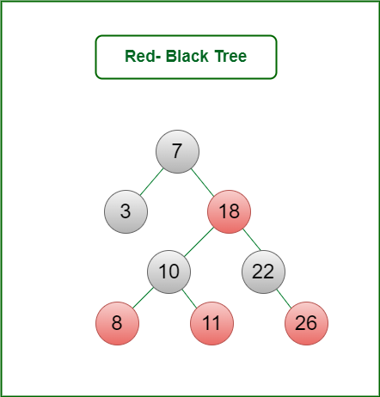
definitions : types of tree
Types of Trees based on the node’s values:
Binary search tree
AVL tree
Red-Black tree: a kind of self-balancing binary search tree where each node has an extra bit, and that bit is often interpreted as the color (red or black). These colors are used to ensure that the tree remains balanced during insertions and deletions.
B and B+ tree
Segment tree

Slide 12
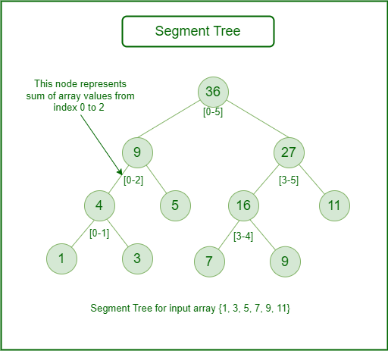
definitions : types of tree
Types of Trees based on the node’s values:
Binary search tree
AVL tree
Red-Black tree
B and B+ tree
Segment tree: known as a statistic tree, is a tree data structure used for storing information about intervals, or segments. It allows querying which of the stored segments contain a given point. It is a static structure that cannot be modified once it’s built.

Slide 13
2.
Binary search tree

Slide 14
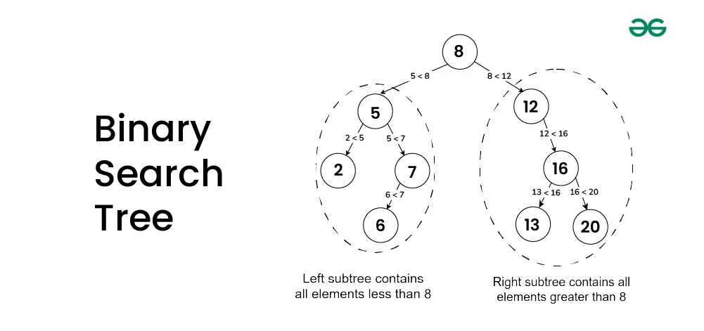
Binary search tree : definition
A Binary Search Tree is a hierarchical data structure with:
Each node has at most 2 child (Left child & Right child)
Each node has key and data
Right child node key > Parent child node key
Left child node key < Parent child node key
Handle same value node:
Left or right or reject but be
consistent

Slide 15
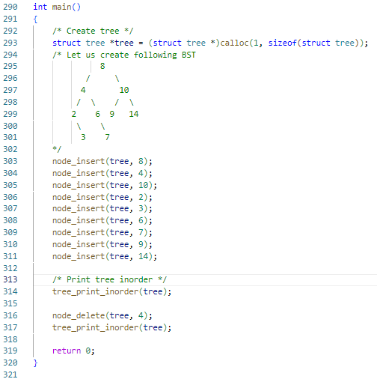
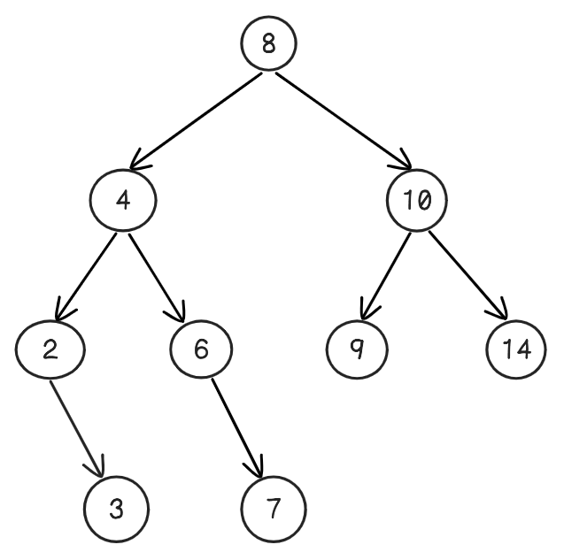
Binary search tree : definition

Slide 16
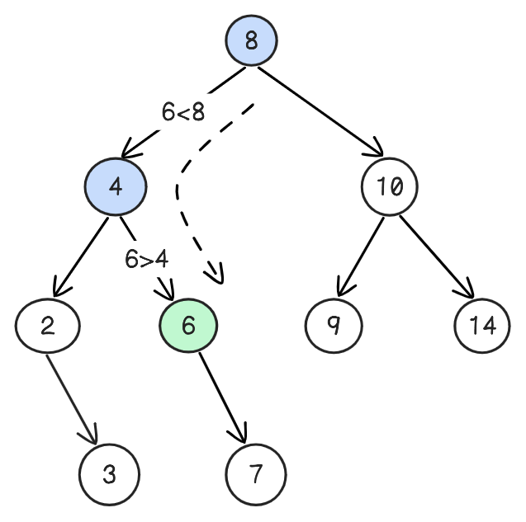
Binary search tree : basic operation
Basic operation:
Seach node
Insert node
Delete node
Tree traversal
Searching in BST means to locate a specific node in the data structure. The steps of searching a node in Binary Search tree are:
Compare the element to be searched with the root node.
If matched then return the node’s location.
If not matched, then check it is smaller than the root node then move to the left subtree.
If it is larger than the root node then move to the right subtree.
Repeat the above procedure recursively until the match is found.
If the element is not found then return NULL.
Complexity: Olog(n)

Slide 17
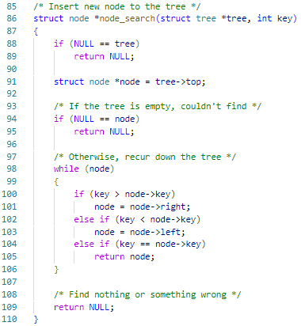
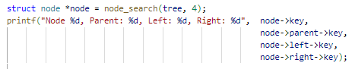
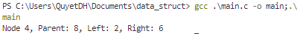
Binary search tree : basic operation

Slide 18
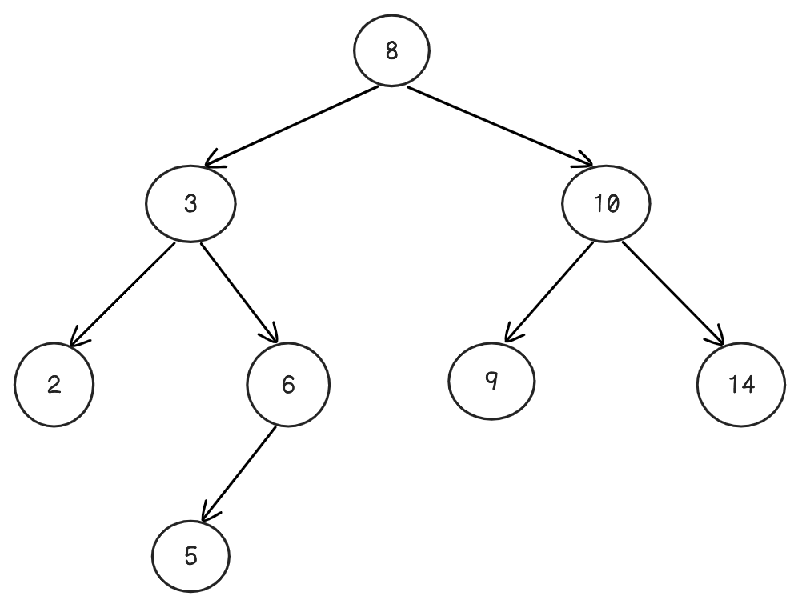
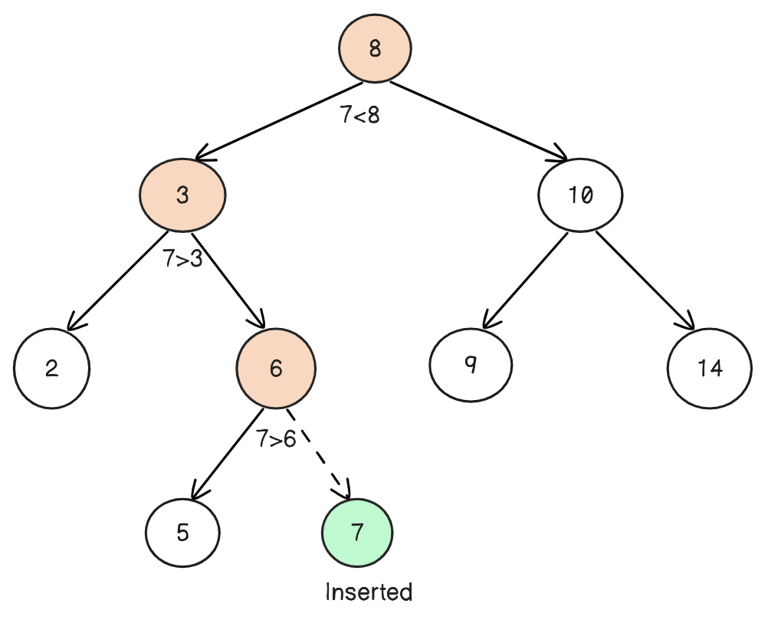
Binary search tree : basic operation
Basic operation:
Seach node
Insert node
Delete node
Tree traversal
A new key is always inserted at the leaf.
Start searching a key from the root till a leaf node. Once a leaf node is found, the new node is added as a child of the leaf node.

Slide 19
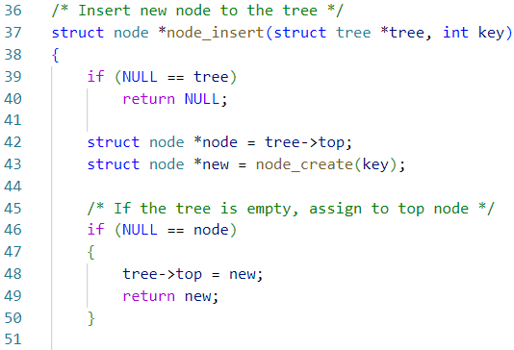
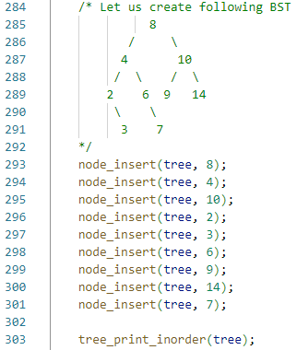
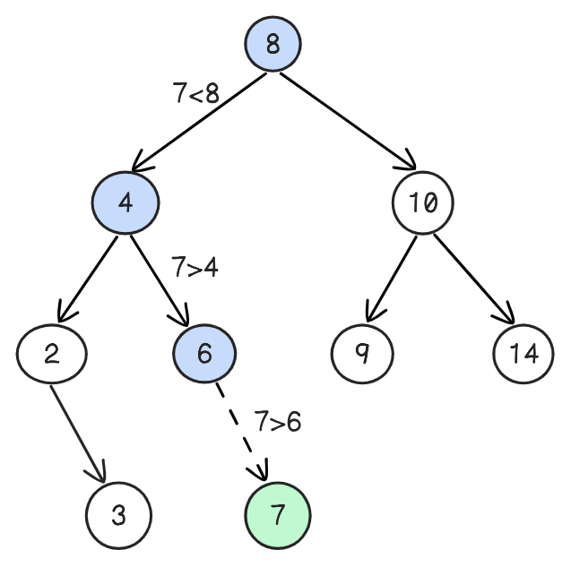
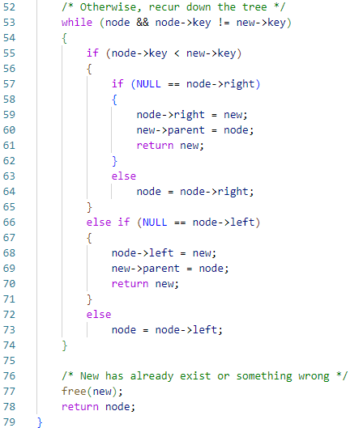
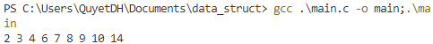
Binary search tree : basic operation

Slide 20
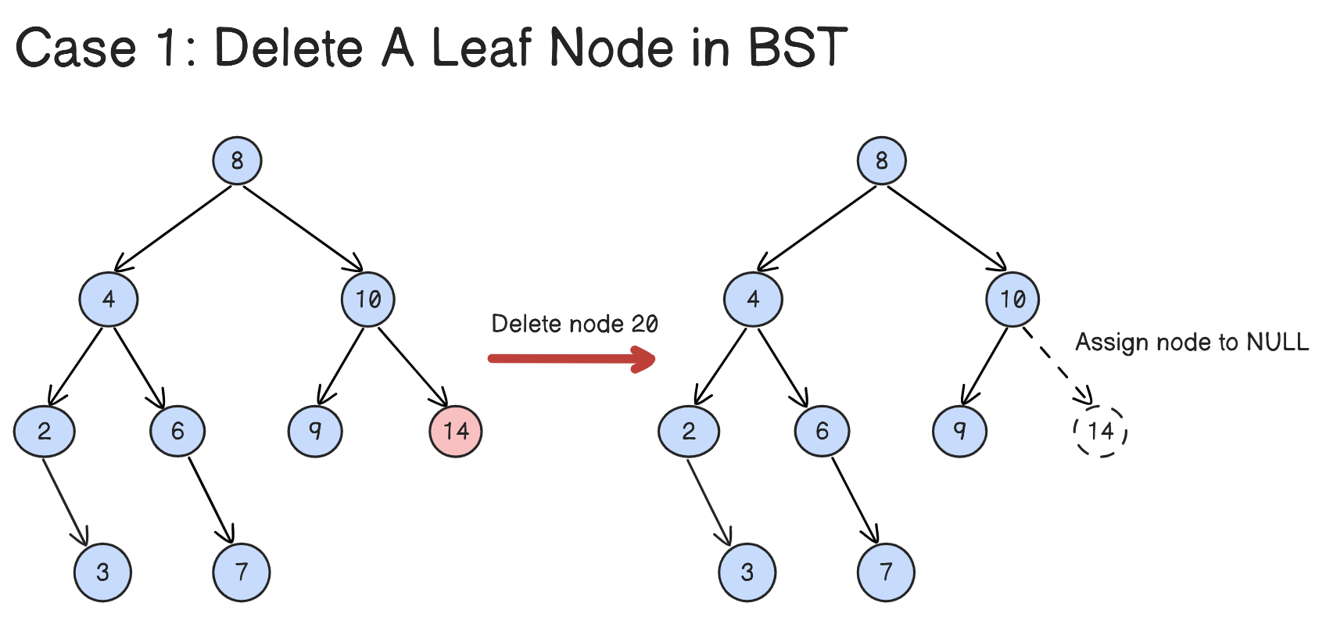
Binary search tree : basic operation
Basic operation:
Seach node
Insert node
Delete node
Tree traversal
It is used to delete a node with specific key from the BST and return the new BST.
Different scenarios for deleting the node:
Case 1: Just simply remove the leaf node

Slide 21
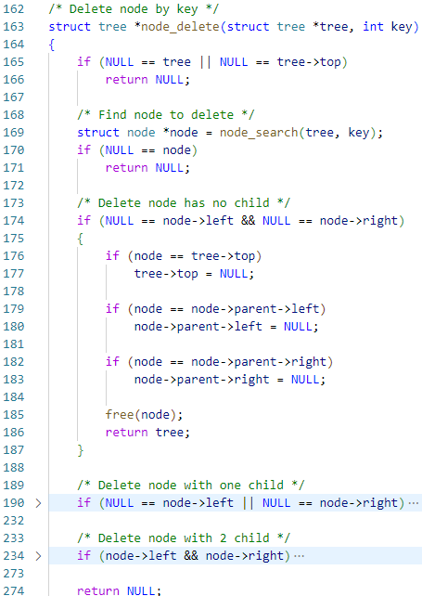
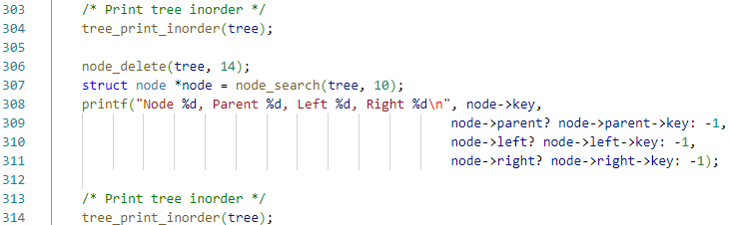
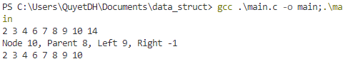
Binary search tree : basic operation

Slide 22
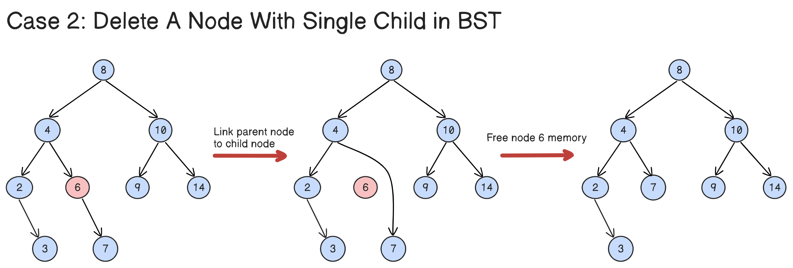
Binary search tree : basic operation
Basic operation:
Seach node
Insert node
Delete node
Tree traversal
Different scenarios for deleting the node:
Case 2: Link child node to parent node then remove current node

Slide 23
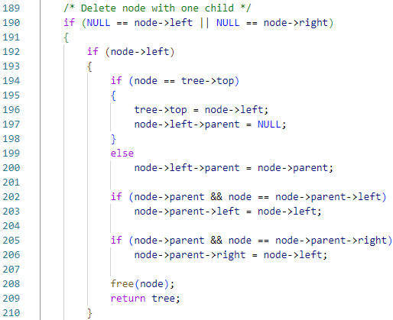
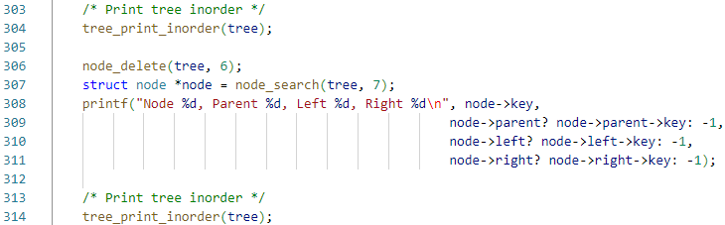
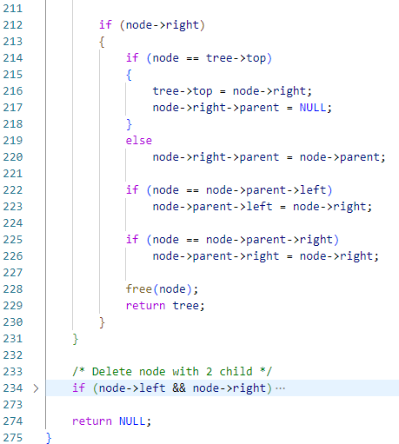
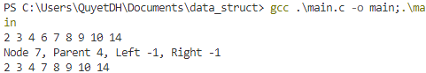
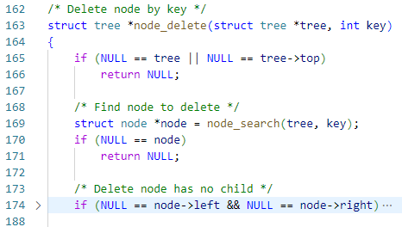
Binary search tree : basic operation

Slide 24
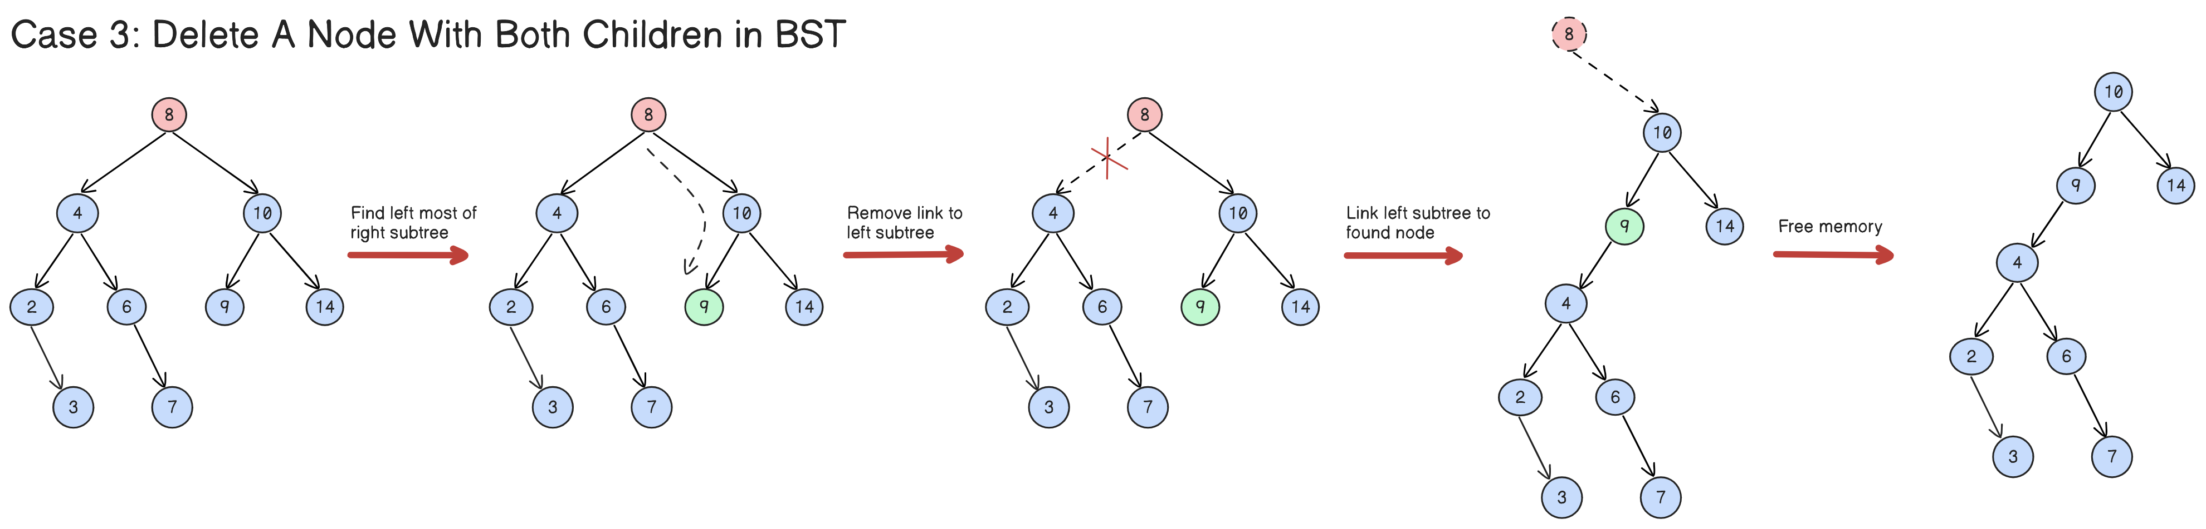
Binary search tree : basic operation
Basic operation:
Seach node
Insert node
Delete node
Tree traversal
Different scenarios for deleting the node:
Case 3: Using minimum node in right subtree to hold the left sub tree

Slide 25
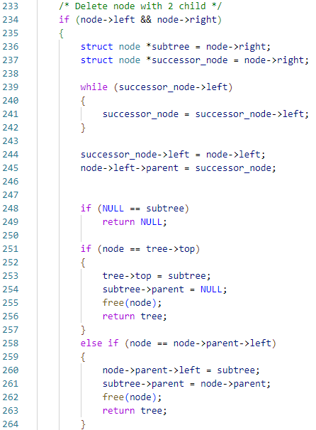
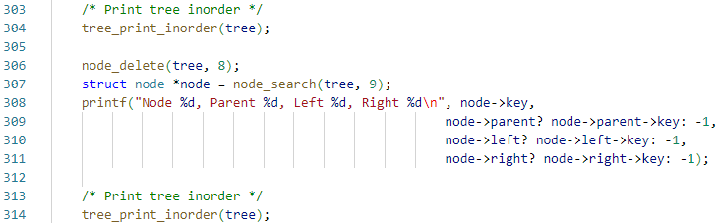
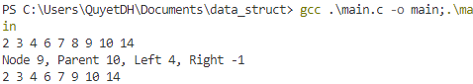
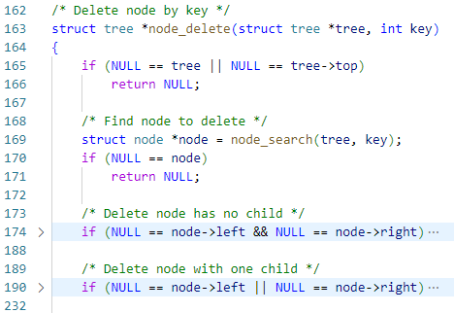
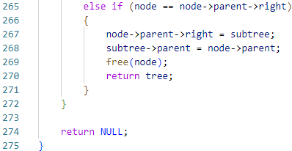
Binary search tree : basic operation

Slide 26
Binary search tree : basic operation
Basic operation:
Seach node
Insert node
Delete node
Tree traversal
To travel through all node of the tree (for print, etc), it have three way traversal:
Inorder traversal
Preorder traversal
Postorder traversal

Slide 27
Binary search tree : basic operation
Basic operation:
Seach node
Insert node
Delete node
Tree traversal
Inorder traversal:
At first traverse left subtree then visit the root and then traverse the right subtree.
Gives the values of the nodes in sorted order.

Slide 28
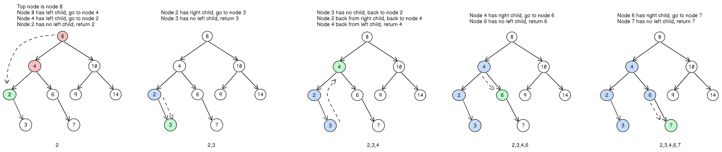
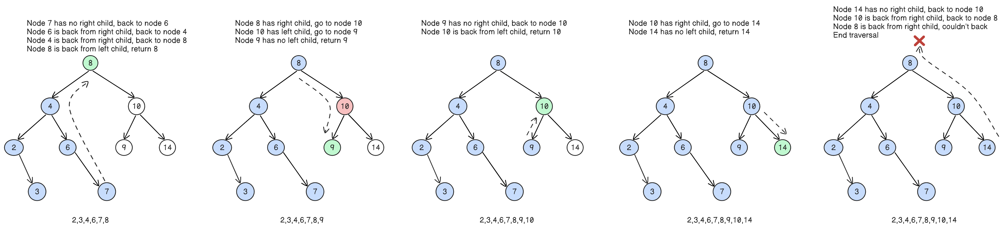
Binary search tree : basic operation

Slide 29
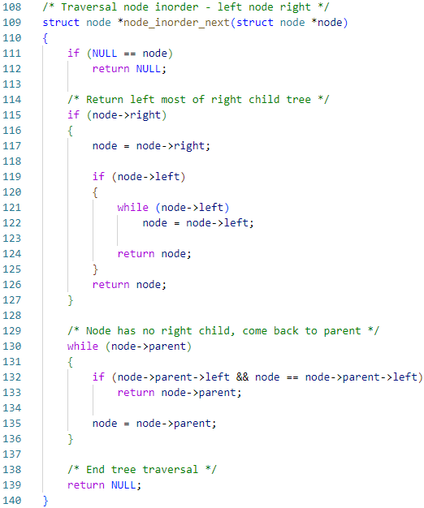
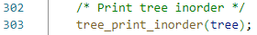
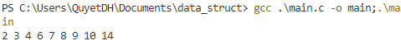
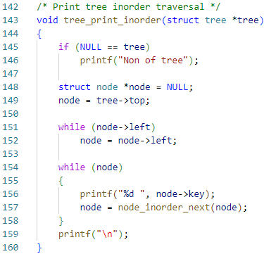
Binary search tree : basic operation

Slide 30
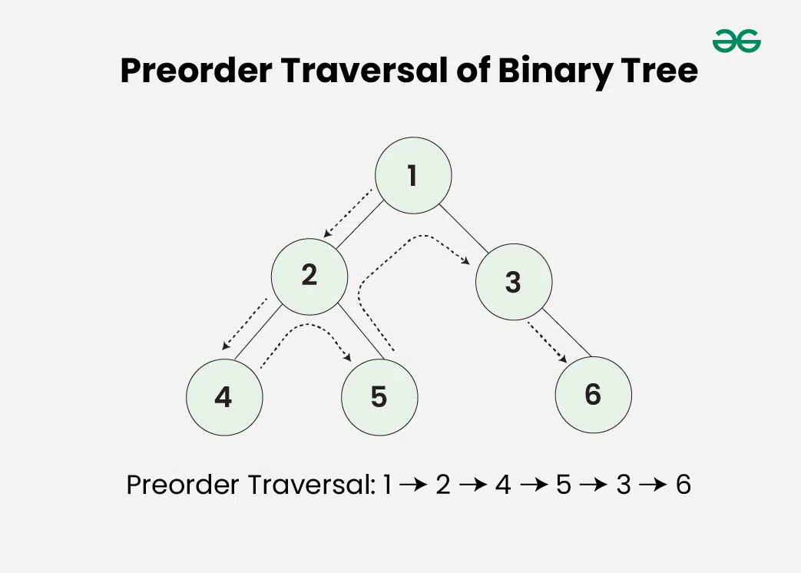
Binary search tree : basic operation
Basic operation:
Seach node
Insert node
Delete node
Tree traversal
Preorder traversal:
Used to create a copy of the tree.
Used to get prefix expressions on an expression tree.

Slide 31
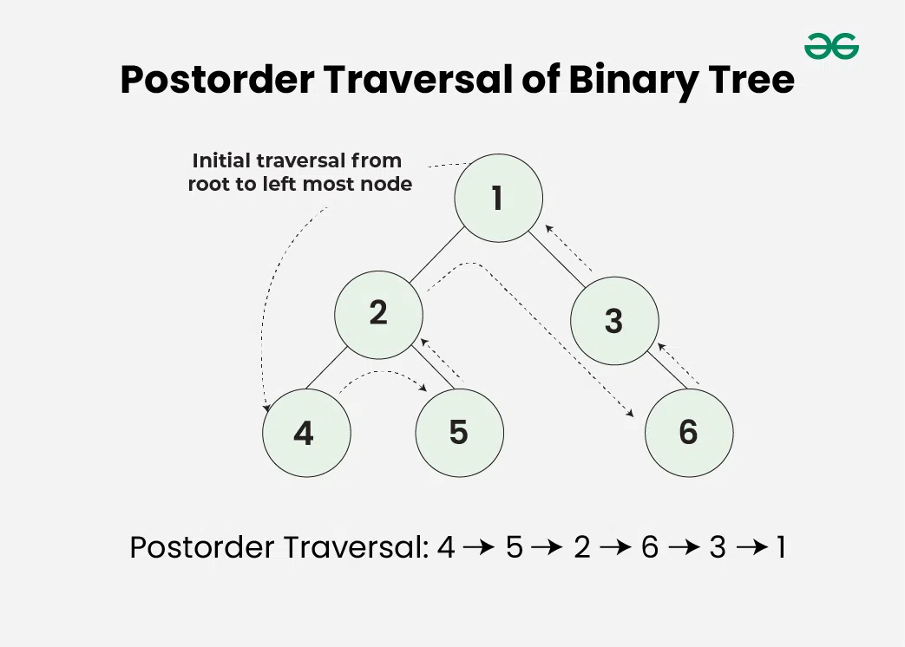
Binary search tree : basic operation
Basic operation:
Seach node
Insert node
Delete node
Tree traversal
Postorder traversal:
Used to delete the tree.
Useful to get the postfix expression of an expression tree.

Slide 32

Binary search tree : Pros and cons
Advantage:
Efficient searching: O(log n) time complexity for searching
Ordered structure: easy to find the next or previous element
Dynamic insertion and deletion: Elements can be added or removed efficiently
Disadvantage:
Not self-balancing effect that time complexity in worst-case is linear: O(n)
Memory overhead: require additional memory to store pointers to child nodes
Limited functionality: BSTs only support searching, insertion, and deletion operations

Slide 33
Binary search tree : application
Searching: Finding a specific element in a sorted collection
Sorting: Sorting a collection of elements in ascending or descending order
Range queries: Finding elements within a specified range
Data storage: Storing and retrieving data in a hierarchical manner
Databases: Indexing data for efficient retrieval
Computer graphics: Representing spatial data in a tree structure
Artificial intelligence: Decision trees and rule-based systems

Slide 34
3.
Binary Search Tree Application:
Routing table

Slide 35



routing table
A routing table is a set of rules, often viewed in table format, that's used to determine where data packets traveling over an Internet Protocol (IP) network will be directed.
To handle network traffic, a router consults its routing tables millions of times each second
127.128.1.1/24 | PORT 3
172.168.1.2/23 | PORT 4
I want to go 127.128.1.1/24
Go to port 3

Slide 36
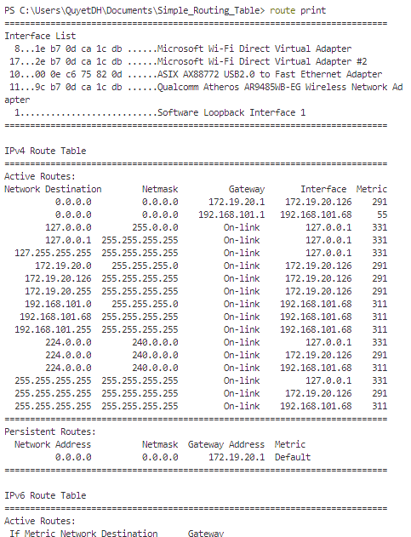
routing table
Routing table require:
Store IPv4, IPv6 routing
Searching node as quick as posible
Solution:
Using binary search tree for quick searching
Using prefix as key

Slide 37
routing table – NAVigation
Data type
All function
create_prefix
printf_prefix
route_table_init
route_table_id_set
route_table_has_info
route_table_print_info
route_table_print_table
route_table_finish
route_top & maskbit
set_link & prefix_match
prefix_copy & route_node_create & route_node_set & route_common
route_node_match
route_node_get
route_node_lookup
route_next
route_node_printf
route_lock_node
route_unlock_node
route_node_delete
route_node_free

Slide 38
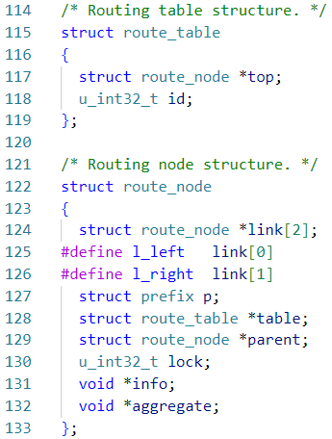
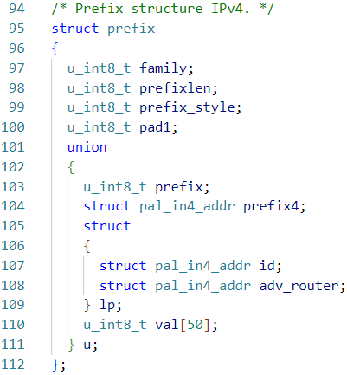
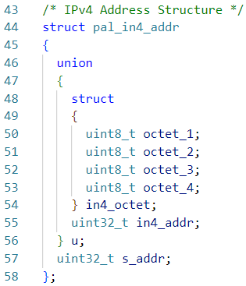
routing table – define Data type
Routing table data type:

Slide 39
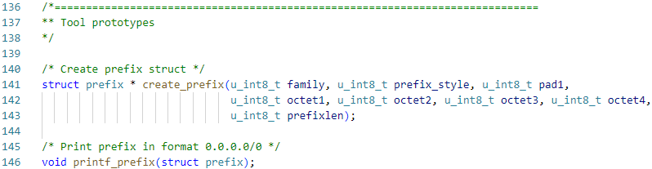
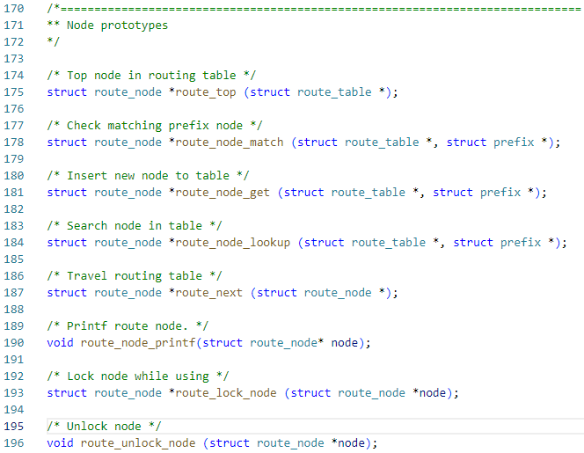


routing table – define prototype function

Slide 40


routing table – declare tool function

Slide 41




routing table – declare table function

Slide 42


routing table – declare table function

Slide 43



routing table – declare table function

Slide 44


routing table – declare Node function

Slide 45


routing table – declare Node function

Slide 46





routing table – declare Node function

Slide 47

routing table – declare Node function

Slide 48


routing table – declare Node function

Slide 49


routing table – declare Node function

Slide 50

routing table – declare Node function

Slide 51


routing table – declare Node function

Slide 52


routing table – declare Node function

Slide 53

routing table – declare Node function

Slide 54


routing table – declare Node function

Slide 55


routing table – init table
main.c
table.c

Slide 56


routing table – Creating a node – TOP Node
main.c
table.c

Slide 57



routing table – Creating a node
main.c
table.c

Slide 58

routing table – Creating a node
main.c
table.c

Slide 59

routing table – Deleting a node
main.c
table.c

Slide 60
4.
Avl tree

Slide 61
AVL tree : definition
An AVL tree defined as a self-balancing Binary Search Tree (BST) where the difference between height of left and right subtrees for any node cannot be more than one:
Each node has at most 2 child (Left child & Right child)
Each node has key and data
Right child node key > Parent child node key
Left child node key < Parent child node key
Heights of left and right subtrees <= 1
Handle same value node:
Left or right or reject but be consistent

Slide 62

AVL tree : definition
Height: is the longest road from this node to null node
Balance factor: difference between height of left subtree and right subtree

Slide 63
AVL tree : demo
INSERT 10
0
10
INSERT 15

Slide 64
AVL tree : demo
+1
10
0
15
INSERT 20

Slide 65
AVL tree : demo
+2
10
+1
15
0
20
ROTATE LEFT

Slide 66
AVL tree : demo
0
15
0
0
10
20
INSERT 12

Slide 67
AVL tree : demo
-1
15
+1
0
10
20
0
12
INSERT 9

Slide 68
AVL tree : demo
-1
15
0
0
10
20
0
0
9
12
INSERT 8

Slide 69
AVL tree : demo
-2
15
-1
0
10
20
-1
0
9
12
0
8
ROTATE RIGHT

Slide 70
AVL tree : demo
0
10
-1
0
9
15
0
0
0
8
12
20

Slide 71


AVL tree : init code

Slide 72

AVL tree : print node

Slide 73

AVL tree : rotation
Left rotation and right rotation

Slide 74


AVL tree : right rotate

Slide 75


AVL tree : left rotate

Slide 76
AVL tree : insertion
The Four "out-of-balance" Cases
Case | Description | Rotation to Restore Balance
Left-Left (LL) | The unbalanced node and its left child node are both left-heavy. | A single right rotation.
Right-Right (RR) | The unbalanced node and its right child node are both right-heavy. | A single left rotation.
Left-Right (LR) | The unbalanced node is left heavy, and its left child node is right heavy. | First do a left rotation on the left child node, then do a right rotation on the unbalanced node.
Right-Left (RL) | The unbalanced node is right heavy, and its right child node is left heavy. | First do a right rotation on the right child node, then do a left rotation on the unbalanced node.

Slide 77




AVL tree : insertion
The left-left case:
Left heavy (<0)
Left heavy (<0)
Rotate right
Insert L, C, B
Rotate right

Slide 78




AVL tree : insertion
The right-right case:
Right heavy (>0)
Right heavy (>0)
Rotate left
Insert E, C, F
Rotate left

Slide 79






AVL tree : insertion
The left-right case:
Left heavy - Right heavy
Left heavy - Right heavy
Rotate left
Rotate right
Insert C, F, G
Left rotate
Right rotate

Slide 80






AVL tree : insertion
The right-left case:
Right heavy - Left heavy
Right heavy - Left heavy
Rotate right
Rotate left
Insert G, E, D
Rotate right
Rotate left

Slide 81






AVL tree : deletion
2 child case:

Slide 82






AVL tree : deletion
2 child case:

Slide 83


AVL tree : create node & search node

Slide 84


AVL tree : insert

Slide 85


AVL tree : insert

Slide 86



AVL tree : Main code

Slide 87
AVL tree : REFerence
https://www.w3schools.com/dsa/dsa_data_avltrees.php
https://www.cs.usfca.edu/~galles/visualization/AVLtree.html

Slide 88
5.
Red-black tree

Slide 89

Red-black tree : definition
A Red-Black Tree is a self-balancing binary search tree where each node has an additional attribute: a color, which can be either red or black.
Node Color: Each node is either red or black.
Root Property: The root of the tree is always black.
Red Property: Red nodes cannot have red children (no two consecutive red nodes on any path).
Black Property: Every path from a node to its descendant null nodes (leaves) has the same number of black nodes.
Leaf Property: All leaves (NIL nodes) are black.

Slide 90


Red-black tree : VISUalize

Slide 91

Red-black tree : VISUalize

Slide 92

Red-black tree : VISUalize

Slide 93

Red-black tree : VISUalize

Slide 94

Red-black tree : VISUalize

Slide 95

Red-black tree : VISUalize

Slide 96

Red-black tree : VISUalize

Slide 97

Red-black tree : VISUalize
https://www.cs.usfca.edu/~galles/visualization/RedBlack.html

Slide 98
Thank you
Presenter: Trinh Cao Cuong
4/2024

